Slide 1
Chapter 18: Decision Analysis
Business Analytics: Methods, Models,
and Decisions, 1st edition
James R. Evans

Slide 2
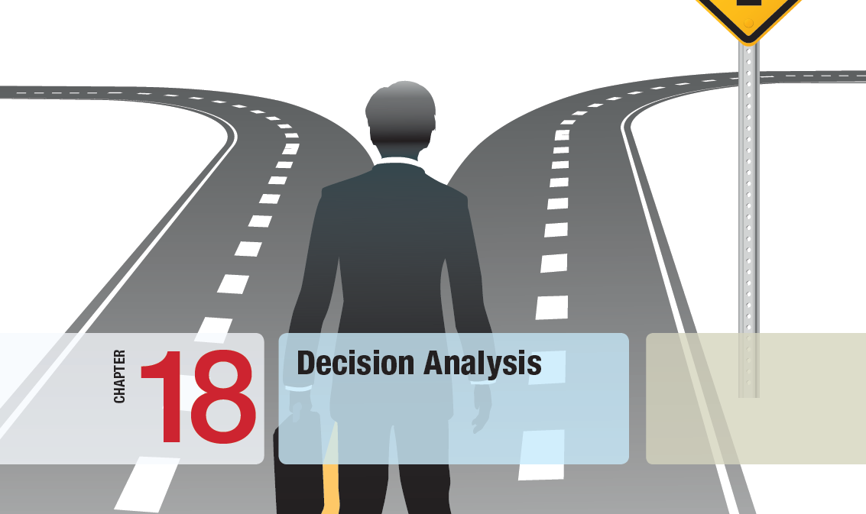

Slide 3
Chapter 18 Topics
Making Decisions with Uncertain Information
Decision Trees
The Value of Information
Utility and Decision Making

Slide 4
Making Decisions with Uncertain Information
The purpose of business analytic models is to provide decision-makers with information needed to make decisions.
There are often trade-offs to consider when making decisions.
Making decisions requires human assessment of factors not included in analytic models.
Understanding the philosophy of decision making and how to deal with uncertainty and risk is vitally important to being a good manager.

Slide 5
Making Decisions with Uncertain Information
Many decisions involve making a choice between a small set of decisions with uncertain consequences.
Such decisions involve:
1. a number of decision alternatives
2. outcomes that may occur (events)
3. payoffs associated with the events
(often summarized in a payoff table)
https://www.homecredit.vn/xe-may

Slide 6
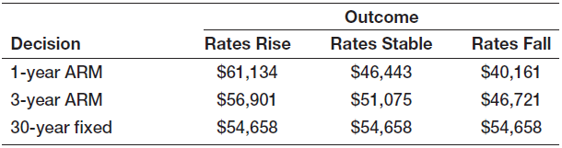
Making Decisions with Uncertain Information
Example 18.1 Selecting a Mortgage Instrument
A family is considering purchasing a new home and wants to finance $150,000.
Three mortgage options are available and the payoff table for the outcomes is shown below.
The payoffs represent total interest paid under three future interest rate situations.
http://mortgage-x.com/general/average_rates.asp

Slide 7
Making Decisions with Uncertain Information
Decision Strategies for a MINIMUM Objective
Average Payoff Strategy
Choose the decision with the smallest average payoff.
Aggressive Strategy - Minimin
Choose the strategy with minimum of the smallest possible payoffs for each decision.
Conservative Strategy - Minimax
Choose the strategy with minimum of the largest possible payoffs for each decision.
Opportunity Loss Strategy - Minimax Regret
Choose the strategy with the minimum opportunity- loss: its payoff – best payoff for that outcome

Slide 8
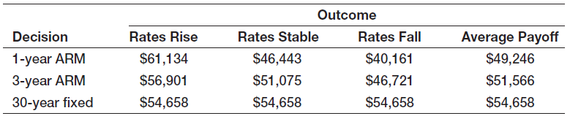
Making Decisions with Uncertain Information
Example 18.2
Mortgage Decision with the Average Payoff Strategy
Suppose the family decides to use the average payoff strategy.
Compute the average interest cost for each type of mortgage and choose the minimum.

Slide 9
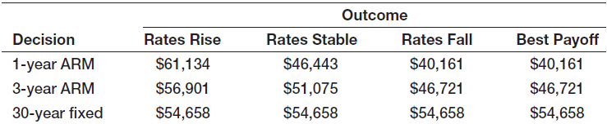
Making Decisions with Uncertain Information
Example 18.3
Mortgage Decision with the Aggressive Strategy
Suppose the family decides to use the aggressive minimin payoff strategy.
Determine the lowest interest cost for each type of mortgage and choose the minimum.

Slide 10
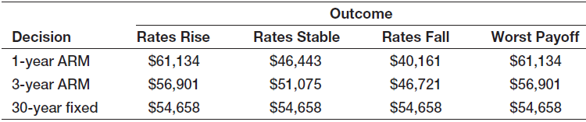
Making Decisions with Uncertain Information
Example 18.4
Mortgage Decision with the Conservative Strategy
Suppose the family decides to use the conservative minimax payoff strategy.
Determine the highest interest cost for each type of mortgage and choose the minimum.

Slide 11
Making Decisions with Uncertain Information
Example 18.5 Mortgage Decision with the Opportunity-Loss Strategy
Suppose the family decides to minimize their opportunity loss (minimax regret strategy).
For each outcome, compute the opportunity loss as follows:
Step 1:
Find the minimum of each column.

Slide 12
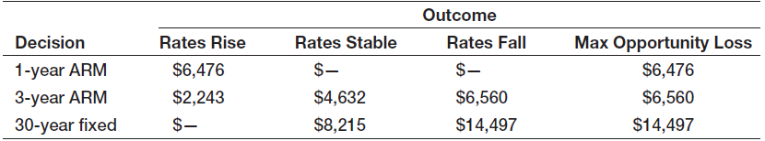
Making Decisions with Uncertain Information
Example 18.5 (continued) Mortgage Decision with the Opportunity-Loss Strategy
Step 2:
Subtract the minimum column value from each value.
a
Step 3: Determine the maximum opportunity loss
(maximum row value) and choose the minimum.

Slide 13
Making Decisions with Uncertain Information
Decision Strategies for a MAXIMUM Objective
→ same basic approaches as for minimum objectives
Average Payoff Strategy
Choose the decision with the largest average payoff.
Aggressive Strategy - Maximax
Choose the strategy with maximum of the largest possible payoffs for each decision.
Conservative Strategy - Maximin
Choose the strategy with minimum of the largest possible payoffs for each decision.
Opportunity Loss Strategy – Minimax Regret
Choose the strategy with the minimum opportunity loss: best payoff for that outcome – its payoff

Slide 14
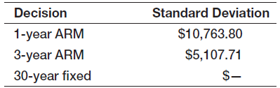
Making Decisions with Uncertain Information
Example 18.6
Evaluating Risk in the Mortgage Decision
Suppose the family has obtained the standard deviations of the interest costs associated with each loan type.
While none of the previous payoff strategies chose the 3-year ARM, it may be attractive to the family due to its moderate risk level and potential upside at stable and falling interest rates.

Slide 15
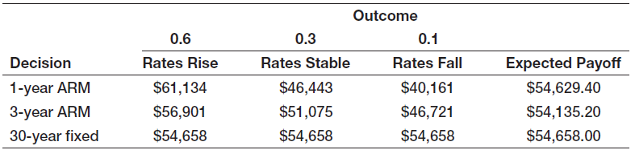
Making Decisions with Uncertain Information
Example 18.7 Mortgage Decision with the Expected Value Strategy
Suppose the family has obtained probability information concerning future interest rates.
For each loan type, compute the expected value of the interest cost and choose the minimum.

Slide 16
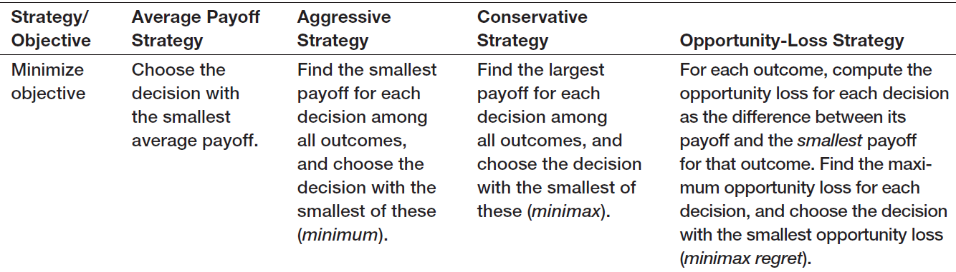
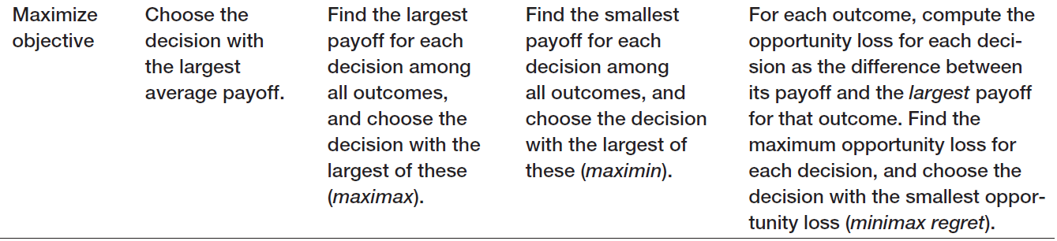
Making Decisions with Uncertain Information
Summary of Decision Strategies Under Uncertainty
Table 18.1

Slide 17
Decision Trees
Decision trees, which consist of nodes and branches, are a useful approach to structuring decision problems involving uncertainty.
Nodes are points in time at which events take place.
Decision nodes are nodes in which a decision takes place by choosing among several alternatives (typically denoted as squares).
Event nodes are nodes in which an event occurs not controlled by the decision-maker (typically denoted as circles).

Slide 18
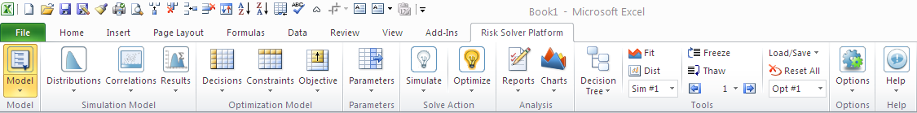
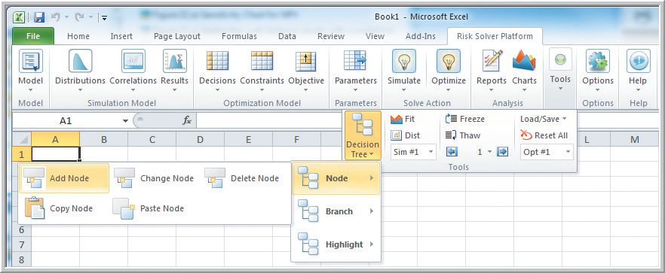
Decision Trees
Decision Tree Menu in Risk Solver Platforms
Figure 18.1

Slide 19
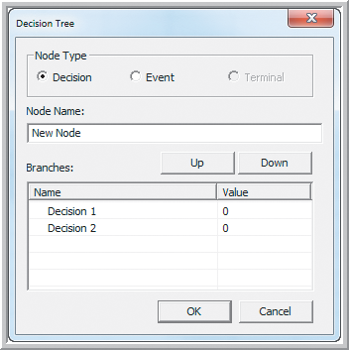
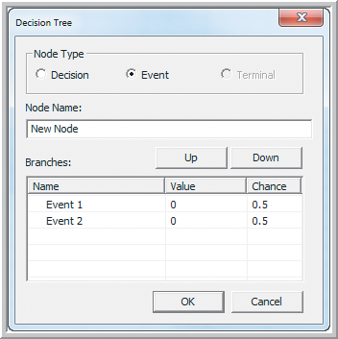
Decision Trees
Decision Tree Node Dialogs in Risk Solver Platform
Figure 18.2

Slide 20
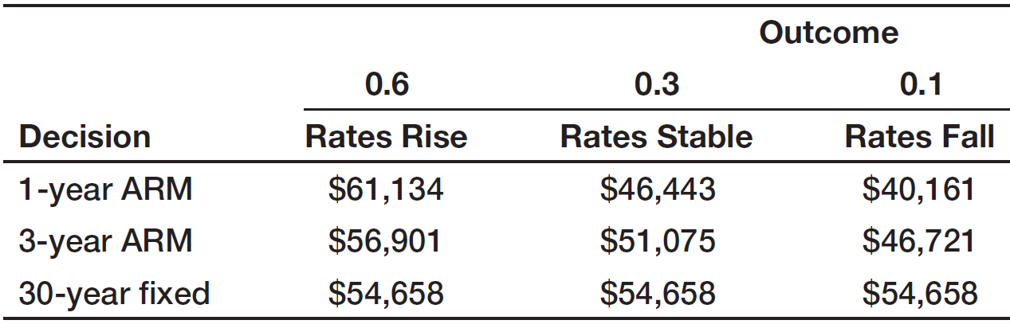
Decision Trees
Example 18.8 Creating a Decision Tree
For the mortgage selection problem, create a decision tree using Risk Solver.
To start the decision tree, add a node for selection of the loan type.
Then, for each type of loan, add a node for selection of the uncertain interest rate conditions.

Slide 21
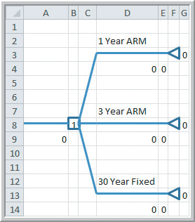
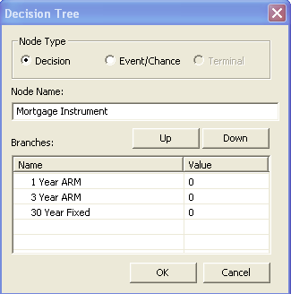
Decision Trees
Example 18.8 (continued) Creating a Decision Tree
Decision Tree > Node > Add Node
Figure 18.3

Slide 22
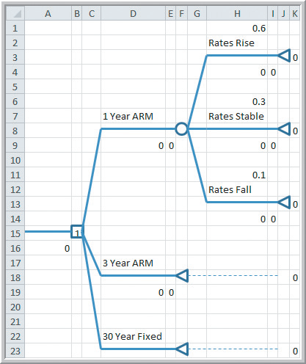
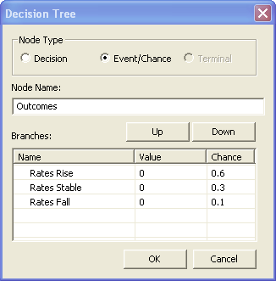
Decision Trees
Example 18.8 (continued) Creating a Decision Tree
Select the 1 Year ARM end node.
Decision Tree > Node > Add Node
Figure 18.4

Slide 23
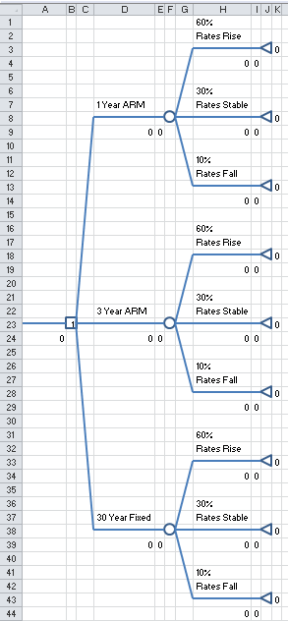
Decision Trees
Example 18.8 (continued)
Creating a Decision Tree
Select 1 Year ARM end node.
Decision Tree > Node > Copy Node
Select 3 Year ARM end node.
Paste Node
Select 30 Year Fixed end node.
Paste Node
From Figure 18.5

Slide 24
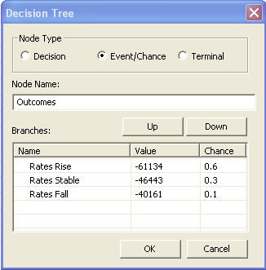
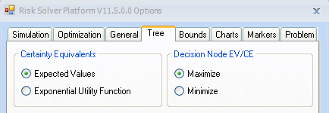
Decision Trees
Example 18.8 (continued)
Creating a Decision Tree
Select the top right branch of the tree.
Decision Tree > Branch > Change Branch
Enter the interest costs as negative values
(or simply enter the values in column H).
Repeat for the other two mortgage types.
Optional:
Change the objective to minimize.
Remove the negative signs from costs.
Options > All Options > Tree > Minimize

Slide 25
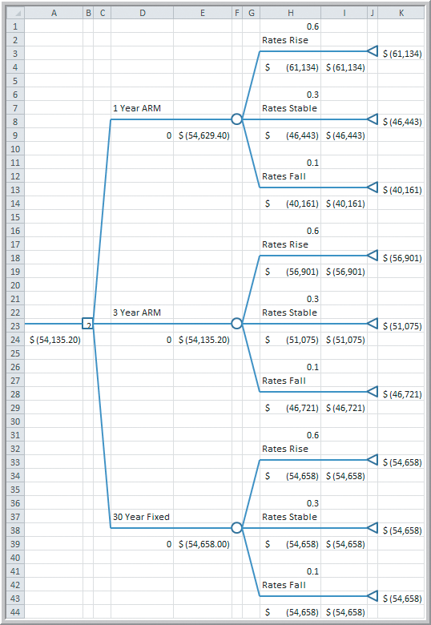
Decision Trees
Example 18.8 (continued)
Creating a Decision Tree
Expected values are computed automatically for the 3 mortgage types.
The maximum expected value is provided at the start of the decision tree.
The 3 Year ARM has the minimum expected interest cost at $54,135.20.
Figure 18.5

Slide 26
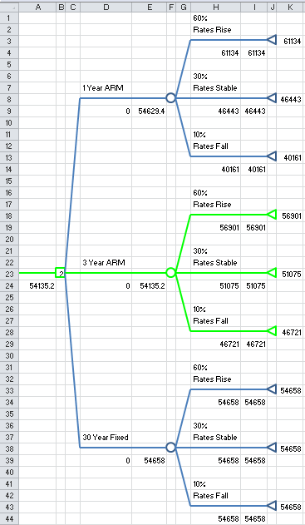
Decision Trees
Example 18.8 (continued)
Creating a Decision Tree
Solved as a Minimization Problem
Best decision can be highlighted
Decision Tree
Highlight
Highlight Best
From Figure 18.5

Slide 27
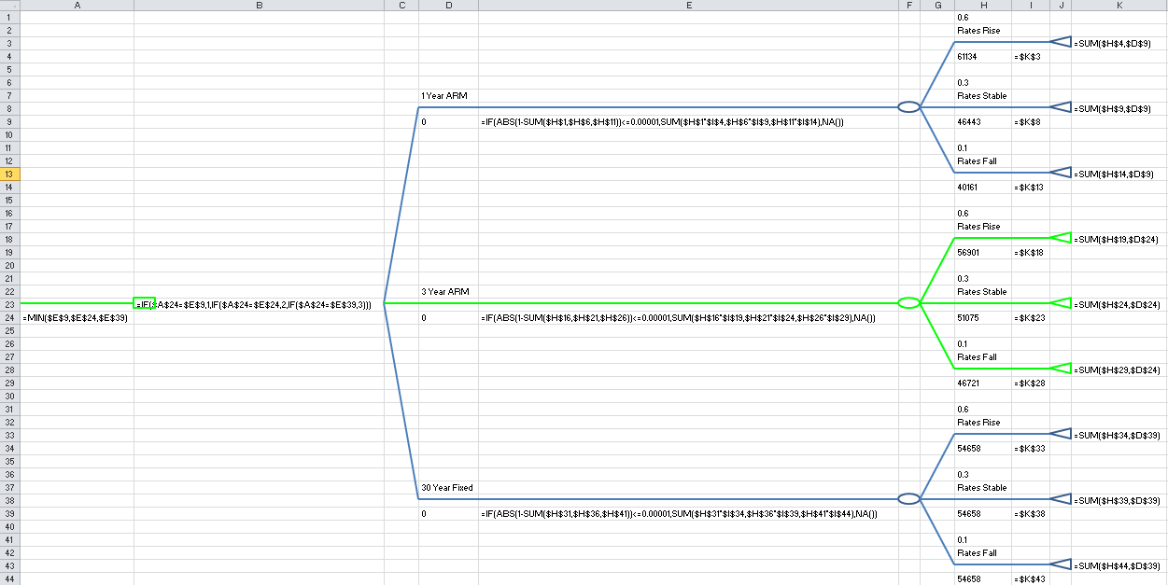
Decision Trees
Example 18.8 (continued) Creating a Decision Tree
Viewing Solver’s Excel Formulas
From Figure 18.5

Slide 28
Decision Trees
Example 18.9 A Pharmaceutical R&D Model
Moore Pharmaceuticals (Example 8.3) needs to decide whether to conduct clinical trials and seek FDA approval for a newly developed drug.
$300 million has already been spent on research.
The next decision is whether to conduct clinical trials at a cost of $250 million.
30% is the likelihood of success following trials.
If the trials are successful, the next decision is whether to seek FDA approval, costing $25 million.
60% is likelihood of FDA approval.

Slide 29
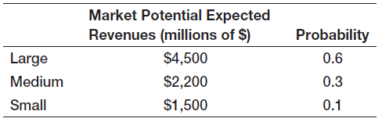
Decision Trees
Example 18.9 (continued)
A Pharmaceutical R&D Model
If the FDA approves the drug, it will be marketed
Market response is uncertain as shown below.
A decision tree can be developed for this scenario.

Slide 30
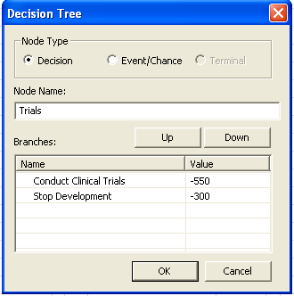
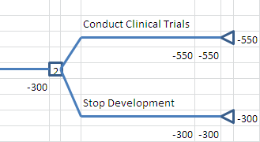
Decision Trees
Example 18.9 (continued)
A Pharmaceutical R&D Model
From Figure 18.6

Slide 31
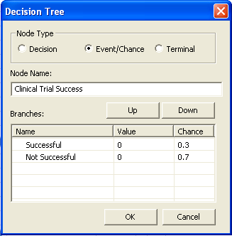
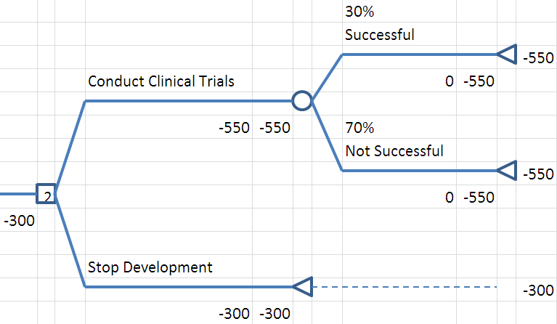
Decision Trees
Example 18.9 (continued)
A Pharmaceutical R&D Model
From Figure 18.6

Slide 32
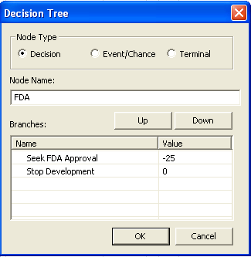
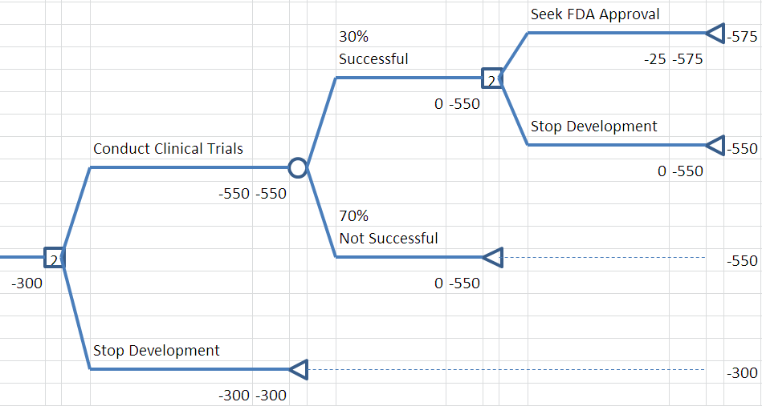
Decision Trees
Example 18.9 (continued)
A Pharmaceutical R&D Model
From Figure 18.6

Slide 33
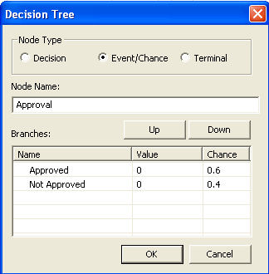
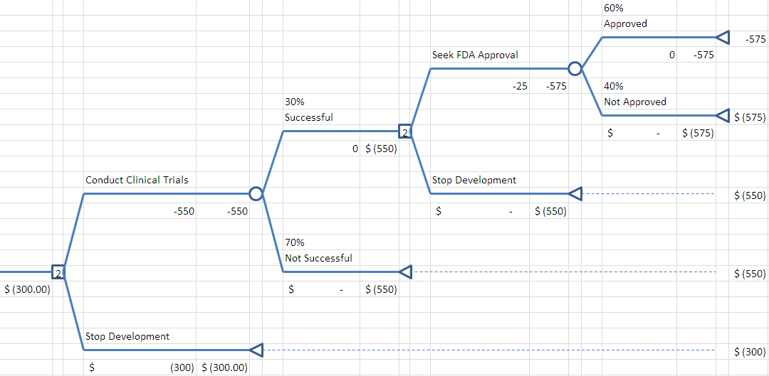
Decision Trees
Example 18.9 (continued)
A Pharmaceutical R&D Model
From Figure 18.6

Slide 34
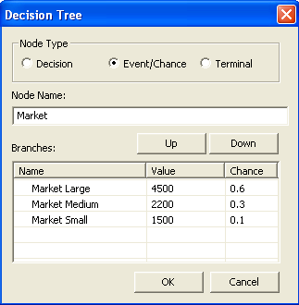
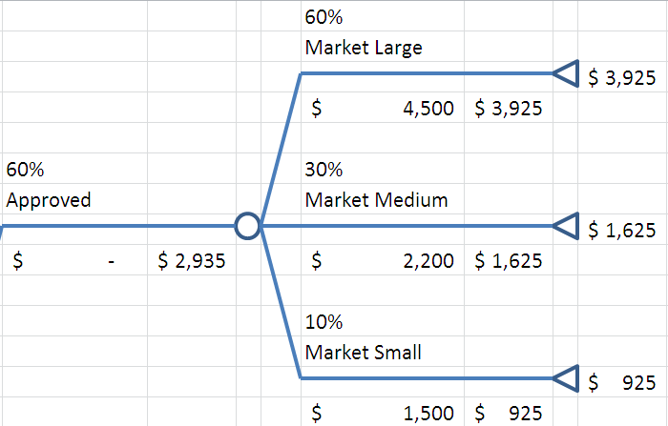
Decision Trees
Example 18.9 (continued)
A Pharmaceutical R&D Model
Partial Decision Tree
From Figure 18.6

Slide 35
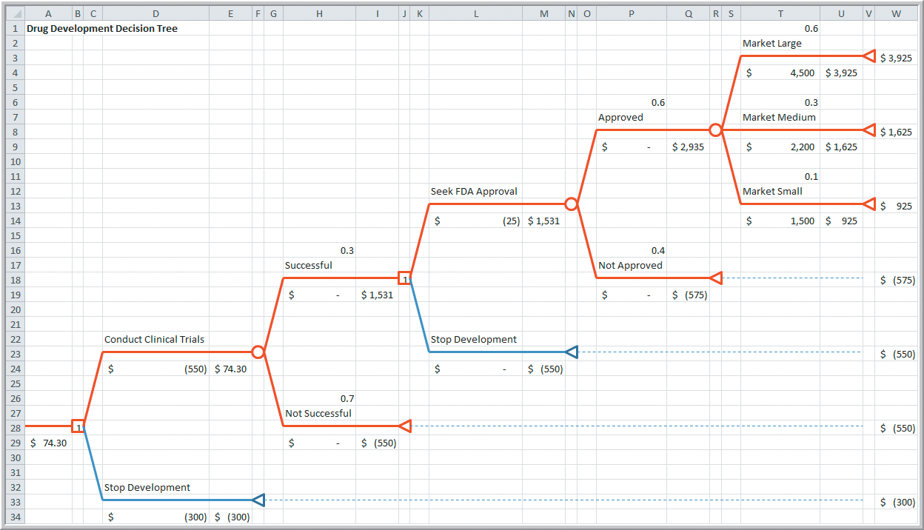
Decision Trees
Example 18.9 (continued)
A Pharmaceutical R&D Model
Completed Decision Tree
Best decision is indicated by the two #1 node numbers.
Conduct clinical trials and, if successful, seek FDA approval.
Expected net revenue = $74.3 million
Figure 18.6

Slide 36
Decision Trees
Example 18.10 Simulating the Drug-Development Decision Tree Model
Suppose there are uncertainties we need to incorporate into the Moore Pharmaceuticals drug development decision tree.
Market payoffs:
Large response: =PsiLogNormal(4500, 1000)
Medium response: =PsiLogNormal(2200, 500)
Small response: =PsiNormal(1500, 200)
Clinical Trial Cost: =PsiTriangular(-700, -550, -500)

Slide 37
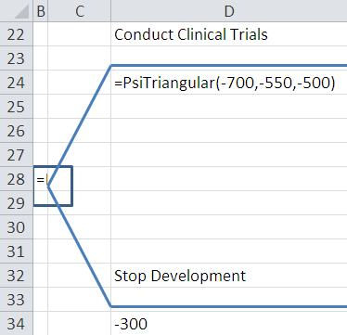
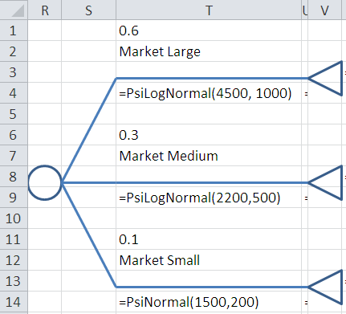
Decision Trees
Example 18.10 (continued) Simulating the Drug-Development Decision Tree Model
From Figure 18.6

Slide 38
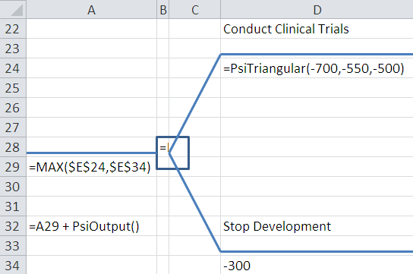
Decision Trees
Example 18.10 (continued) Simulating the Drug-Development Decision Tree Model
To define the changing output cell, we cannot use the decision tree’s net revenue cell (A29).
So, in any empty cell enter, =A29 + PsiOutput()
From Figure 18.6

Slide 39
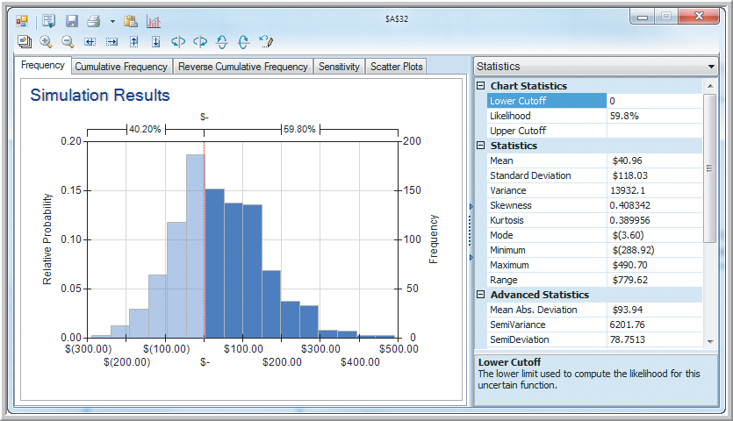
Decision Trees
Example 18.10 (continued) Simulating the Drug-Development Decision Tree Model
Expected net revenue = $47 million
40% chance of losing more money.
Figure 18.7

Slide 40
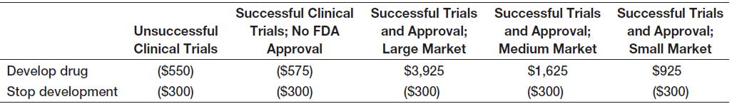
Decision Trees
Decision Trees and Risk
Decision trees are an example of expected value decision making and do not explicitly consider risk.
For Moore Pharmaceutical’s decision tree, we can form a classical decision table.
We can then apply aggressive, conservative, and opportunity loss decision strategies.

Slide 41
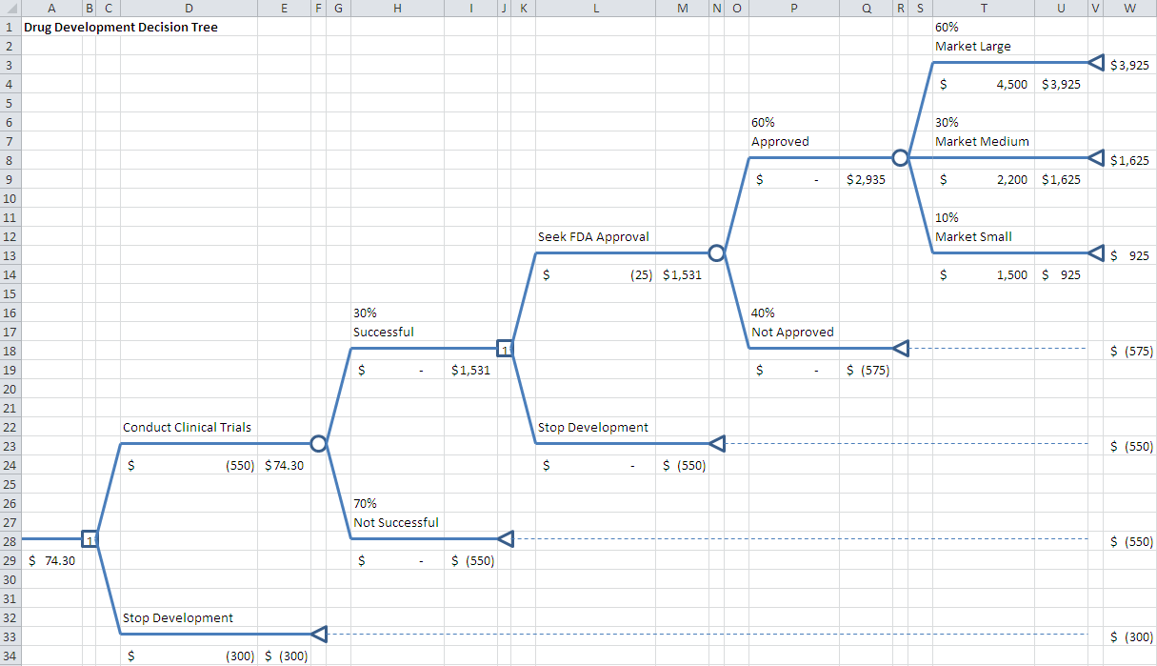
Decision Trees
Decision Trees and Risk (continued)
From Figure 18.6

Slide 42

Decision Trees
Decision Trees and Risk (continued)
Applying the Aggressive Maximax Strategy
Developing the new drug maximizes the maximum payoff.

Slide 43

Decision Trees
Decision Trees and Risk (continued)
Applying the Conservative Maximin Strategy
Stopping development of the new drug maximizes the minimum payoff.

Slide 44
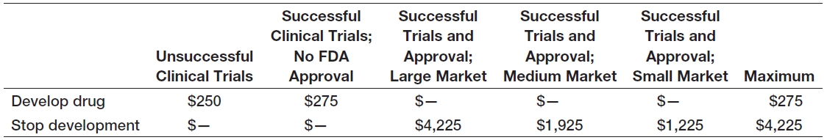
Decision Trees
Decision Trees and Risk (continued)
Applying the Opportunity-Loss Strategy
Developing the new drug minimizes the maximum
opportunity loss.
Opportunity Losses

Slide 45
Decision Trees
Example 18.11 Constructing a Risk Profile
For Moore Pharmaceutical’s drug-development decision, we can easily construct a risk profile using the decision tree probabilities.
Terminal
Outcomes
Figure 18.6

Slide 46
Decision Trees
Example 18.11 (continued)
Constructing a Risk Profile
Compute the probability of each terminal outcome.
P(Large market) = (.3)(.6)(.6) = 0.108
P(Medium market) = (.3)(.6)(.3) = 0.054
P(Small market) = (.3)(.6)(.1) = 0.018
P(FDA not approved) = (.3)(.4) = 0.120
P(Clinical trials not successful) = 0.700
SUM 1.000

Slide 47
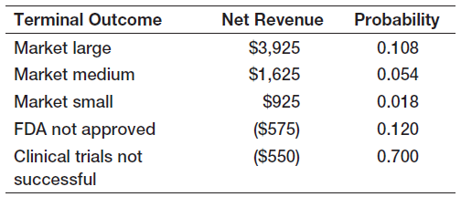
Decision Trees
Example 18.11 (continued) Constructing a Risk Profile
P(never to market) = 1 – 0.108 – 0.054 – 0.018
= 82%
Should they stop now and lose $300 million or continue on and have an 82% chance of losing an additional $550-$575 million?

Slide 48
Decision Trees
Example 18.12 Sensitivity Analysis for Airline Revenue Management Decisions
Recall Example 5.21- Airline Revenue Management
Full and discount airfares are available for a flight.
Full-fare ticket costs $560
Discount ticket costs $400
X = selling price of a ticket
p = 0.75 (the probability of selling a full-fare ticket)
E[X] = 0.75($560) + 0.25(0) = $420
Breakeven point: $400 = p($560) or p = 0.714

Slide 49
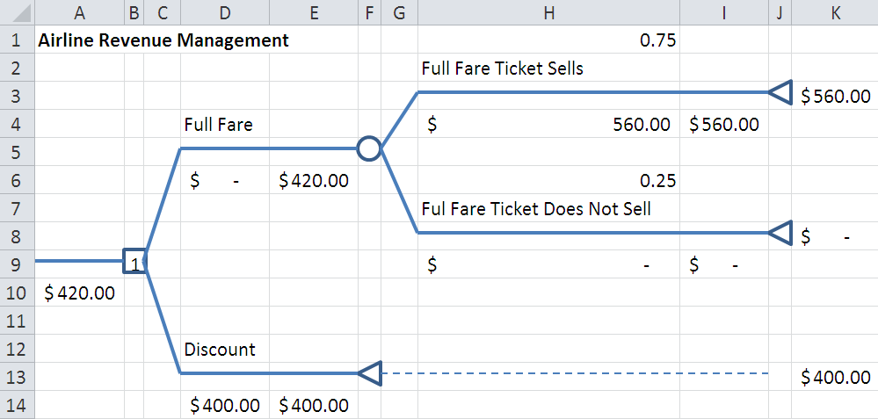
Decision Trees
Example 18.12 (continuity) Sensitivity Analysis for Airline Revenue Management Decisions
From Figure 18.8

Slide 50
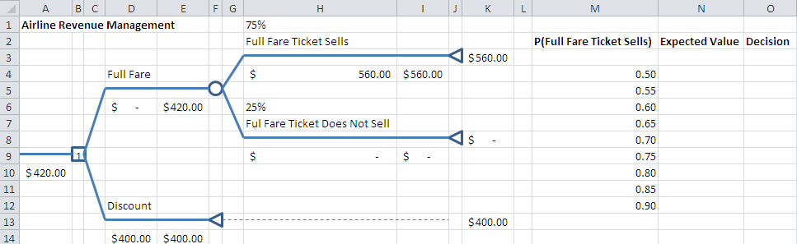
Decision Trees
Example 18.12 (continuity) Sensitivity Analysis for Airline Revenue Management Decisions
Create a Data Table that varies full fare probabilities.
Select M3:O12
Data Table
Column Input Cell: H1
=IF(B9=1,”Full”,”Discount”)
=A10
=1-H1
From Figure 18.8

Slide 51
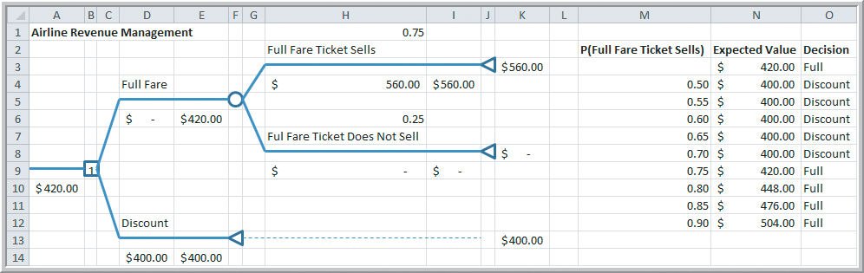
Decision Trees
Example 18.12 (continued) Sensitivity Analysis for Airline Revenue Management Decisions
Figure 18.8
Discount the price if the probability of selling a full fare ticket is 70% or less.

Slide 52
The Value of Information
Expected Value of Perfect Information (EVPI)
The value of information is the improvement in return if additional information is acquired.
Perfect information tell us, with certainty, which outcome will occur.
EVPI is expected monetary value (EMV) with perfect information minus the EMV without it.
Expected opportunity loss is the average additional amount the investor would have achieved if the correct decision had been made.
Minimizing expected opportunity loss always results in the same decision as maximizing expected value.

Slide 53
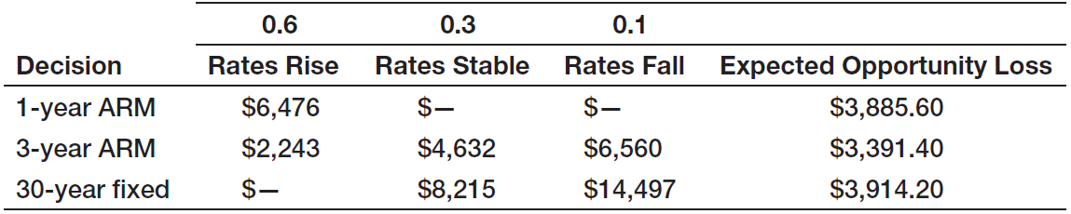
The Value of Information
Example 18.13
Finding EVPI for the Mortgage-Selection Decision
Opportunity Losses
= EVPI

Slide 54
The Value of Information
Example 18.13 (continued)
Finding EVPI for the Mortgage-Selection Decision
Best decision
$54,658
$46,443
$40,161
$50.743.80
Difference = EVPI
$3391.40
The family should not pay more than $3391.40 for any information about future interest rates, no matter how good.

Slide 55
The Value of Information
Decisions with Sample Information
Sample information is the result of conducting some type of experiment.
Examples include marketing research studies or interviewing experts.
Sample information is always imperfect and often comes at a cost.
The expected value of sample information (EVSI) is the EMV of the outcome with sample information minus the EMV without it.

Slide 56
The Value of Information
Example 18.14 Decisions with Sample Information
A company is developing a new cell phone and currently has two models under consideration.
70% of their new phones have high consumer demand and 30% have low consumer demand.
Model 1 requires $200,000 investment.
If demand is high, revenue = $500,000
If demand is low, revenue = $160,000
Model 2 requires $175,000 investment.
If demand is high, revenue = $450,000
If demand is low, revenue = $160,000

Slide 57
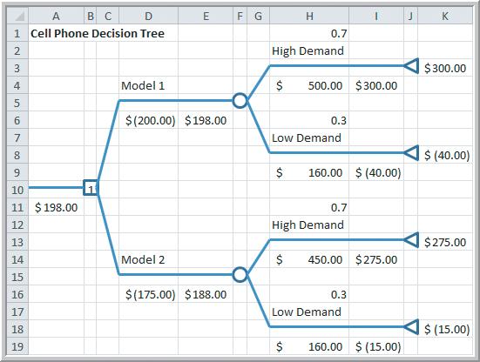
The Value of Information
Example 18.14 (continued)
Decisions with Sample Information
Decision tree units are $000.
Choose Model 1
Expected profit
= $198,000
Figure 18.9

Slide 58
The Value of Information
Example 18.14 (continued)
Decisions with Sample Information
Suppose a market research study is conducted.
It is known that market research is not completely accurate since, in the past:
90% of all products that had high consumer demand received high market survey responses.
20% of all products that had low consumer demand received high market survey responses.
We can update the decision tree using Bayes’s rule.

Slide 59
The Value of Information
Bayes’s Rule for Computing Conditional Probabilities
Bayes’s rule allows revising historical probabilities based on new sample information.
For the cell phone example:
D_{L} = low demand
D_{H} = high demand
M_{L} = low market survey response
M_{H} = high market survey response

Slide 60
The Value of Information
Example 18.15 Applying Bayes’s Rule to Compute Conditional Probabilities
P(D_{H}) = 0.70 P(D_{L}) = 0.30
P(M_{H} |D_{H}) = 0.90 P(M_{L} |D_{H}) = 1 − 0.90 = 0.10
P(M_{H} |D_{L}) = 0.20 P(M_{L} |D_{L}) = 1 − 0.20 = 0.80
P(D_{H} |M_{H}) = (.9)(.7)/[(.9)(.7)+(.2)(.3)] = 0.913
P(D_{L} |M_{H}) = 1 − 0.913 = 0.087
P(D_{H} |M_{L}) = (.1)(.7)/[(.1)(.7)+(.8)(.3)] = 0.226
P(D_{L} |M_{L}) = 1 − 0.226 = 0.774

Slide 61
The Value of Information
Example 18.15 (continued) Applying Bayes’s Rule to Compute Conditional Probabilities
P(M_{H}) = P(M_{H} |D_{H})*P(D_{H}) + P(M_{H} |D_{L})*P(D_{L})
= (.9)(.7) + (.2)(.3)
= 0.69
P(M_{L}) = P(M_{L} |D_{H})*P(D_{H}) + P(M_{L} |D_{L})*P(D_{L})
= (.1)(.7) + (.8)(.3)
= 0.31

Slide 62
The Value of Information
Example 18.15 (continued) Applying Bayes’s Rule to Compute Conditional Probabilities
Joint probability table for the cell phone example.
 | High Survey Response M_{H} | Low Survey Response M_{L}
High Demand D_{H} | 0.63 | 0.07 | 0.70
Low Demand D_{L} | 0.06 | 0.24 | 0.30
 | 0.69 | 0.31 | 1.00

Slide 63

The Value of Information
Example 18.15 (continued) Applying Bayes’s Rule to Compute Conditional Probabilities
0.913 = P(D_{H} |M_{H})
0.69 = P(M_{H})
0.087 = P(D_{L} |M_{H})
Expected profit =$202,260
0.226 = P(D_{H} |M_{L})
0.774 = P(D_{L} |M_{L})
0.31 = P(M_{L})
Figure 18.10

Slide 64
The Value of Information
Example 18.15 (continued) Applying Bayes’s Rule to Compute Conditional Probabilities
The expected profit in Example 18.14 (without additional information) is $198,000.
The expected profit in Example 18.15 (with additional information) is $202,260.
The EVSI = $4260.
The company should not pay more than $4260 for a market research survey.
Figure 18.10

Slide 65
Utility and Decision Making
Utility theory is an approach for assessing risk attitudes quantitatively.
An individual’s utility function reflects their preference toward risk.
The risk premium is the payoff amount that an individual is willing to forgo to avoid risk.
The break-even probability is the point at which an individual is indifferent between a guaranteed payoff and taking a gamble for a higher payoff.
The certainty equivalent is the amount an individual feels is equivalent to the payoff from an uncertain gamble.

Slide 66

Utility and Decision Making
Example 18.16 A Personal Investment Decision
Suppose you have $10,000 to invest short-term.
You are considering 3 options:
- Bank CD paying 4% return
- Bond fund with uncertain return
- Stock fund with uncertain return
Table 18.2

Slide 67

Utility and Decision Making
Example 18.17 Constructing a Utility Function for the Personal Investment Decision
Sort the payoff amounts from highest to lowest.
Assign a utility to the highest payoff of U(X) = 1.
Assign a utility to the lowest payoff of U(X) = 0.
U(1700) = 1
U(1000) = the probability you would give up
a certain $1000 to possibly win a
$1700 payoff.
U(−900) = 0

Slide 68

Utility and Decision Making
Example 18.17 Constructing a Utility Function for the Personal Investment Decision
After deciding U(1000) = 0.90, continue choosing U(X) preferences for the remaining four payoffs.

Slide 69


Utility and Decision Making
Example 18.17 (continued) Constructing a Utility Function for the Personal Investment Decision
For the $1000 payoff with U(1000) = 0.90
Expected payoff = $1440
Risk premium = $440
For the $840 payoff with U(840) = 0.85
Expected payoff = $1310
Risk premium = $470
Figure 18.17

Slide 70
Utility and Decision Making
Example 18.17 (continued) Constructing a Utility Function for the Personal Investment Decision
We can find the breakeven probability for each payoff by solving
Payoff = $1700p − $900(1−p)
p = (Payoff + 900)/2600
Payoff, X | Utility, U(X) | Expected Payoff | Risk Premium | Break-even Probability
$1,700 | 1.00
$1,000 | 0.90 | $1,440 | $440 | 0.73
$840 | 0.85 | $1,310 | $470 | 0.67
$600 | 0.80 | $1,180 | $580 | 0.58
$400 | 0.75 | $1,050 | $650 | 0.50
-$500 | 0.35 | $10 | $510 | 0.15
-$900 | 0.00

Slide 71

Utility and Decision Making
Example 18.17 (continued) Constructing a Utility Function for the Personal Investment Decision
Risk Aversion
Risk premiums > 0
U(X) > Risk neutral
Concave downward
Figure 18.12

Slide 72

Utility and Decision Making
Example of a Risk Taking Utility Function
Payoff, X | Utility, U(X) | Expected Payoff | Risk Premium | Break-even Probability
$1,700 | 1.00
$1,000 | 0.60 | $660 | -$340 | 0.73
$840 | 0.55 | $530 | -$310 | 0.67
$600 | 0.45 | $270 | -$330 | 0.58
$400 | 0.40 | $140 | -$260 | 0.50
-$500 | 0.10 | -$640 | -$140 | 0.15
-$900 | 0.00
Risk Taker
Risk premiums < 0
U(X) < Break-even Probability
Concave upward utility function

Slide 73

Utility and Decision Making
Using a Utility Function Instead of Payoffs
Expected values of the risk averse utilities
Expected values of the payoffs for each decision
Average Payoff
$400
$447
$467
Table 18.2

Slide 74
Utility and Decision Making
Using a Utility Function Instead of Payoffs (continued)
Expected values of the risk taker utilities
Expected values of the payoffs for each decision
0.40
0.10
0.00
0.40
0.55
0.45
0.40
0.60
1.00
0.40
0.42
0.48
Average Payoff
$400
$447
$467
Table 18.2

Slide 75


Utility and Decision Making
Exponential Utility Function
Rather than asking the decision-maker to specify their utility for each payoff possibility, an exponential utility function might be used.
R is a shape parameter
indicative of risk tolerance.
Smaller values of R have
a more concave U(X)
and are more risk averse.
Figure 18.13

Slide 76
Utility and Decision Making
Exponential Utility Function (continued)
One approach to estimating an appropriate value of R for the decision maker is to:
Find the maximum payoff $R for which the decision maker believes that taking a chance to win $R is equivalent to losing $R/2.
Would you take on a bet of possibly winning $10 versus losing $5?
How about risking $50 to win $100?
How about risking $500 to win $1000?
R measures one’s maximum risk comfort level.

Slide 77


Utility and Decision Making
Example 18.18
Using an Exponential Utility Function
In the $10,000 Personal Investment Decision example, suppose you use an exponential utility function with R = $400.
U(X) = 1 – e^{-X/400}
You are willing to risk $200 to win $400.

Slide 78

Utility and Decision Making
Analytics in Practice:
Using Decision Analysis in Drug Development
Pharma, a business unit of Bayer Pharmaceuticals, developed a new blood-clot-busting drug.
They used a structured decision analysis approach to evaluate market potential of the drug.
A decision tree with 6 decision points delivered to senior managers the expected net present value, the likelihood of success, and the risks involved.
This decision tree approach set new standards for subsequent new drug developments at Pharma.

Slide 79
Chapter 18 - Key Terms
Branches
Certainty equivalent
Decision node
Decision strategy
Decision tree
Event
Event node
Expected opportunity loss
Expected value of perfect information
Expected value of sample information
Laplace, or average, payoff strategy
Maximax strategy
Maximin strategy

Slide 80
Chapter 18 - Key Terms (continued)
Minimax regret strategy
Minimax strategy
Minimin strategy
Nodes
Payoff table
Perfect information
Risk averse
Risk premium
Risk profile
Sample information
Utility theory
Value of information

Slide 81
Case Study Performance Lawn Equipment (18)
Recall that PLE produces lawnmowers and a medium size diesel power lawn tractor.
PLE has developed a prototype for a new snow blower to help balance its seasonal demand.
Management needs to decide whether to introduce the product globally or just in the North American market.
You need to construct a decision tree, determine the optimal strategy, and develop a risk profile.
Write a formal report summarizing your results.

Slide 82


